Slide 1
Operating Systems and Computer Security
4 Operating System Security

Slide 2
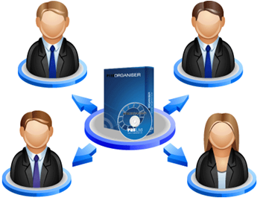
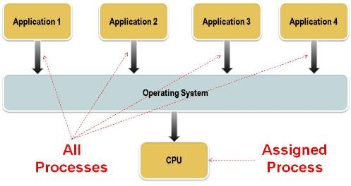
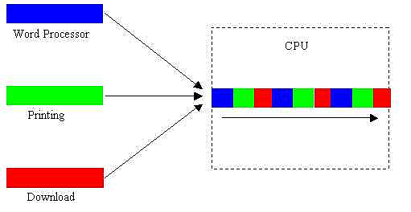
Operating System
Multi user
Multi tasking
Access control
  Controlling shared access
  Interface to allow that access

Slide 3
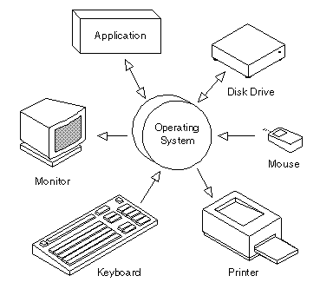
Protected Objects
Memory
Files on auxiliary storage
I/O devices
Programs and sub procedures
Networks
Data
  Supported by hardware

Slide 4
Access Control to General Objects
Goals in protecting objects
  Check every access
  Enforce least privilege
  Verify acceptable usage
  Objects
  Subjects
  Unique owner - possesses "control" access rights

Slide 5
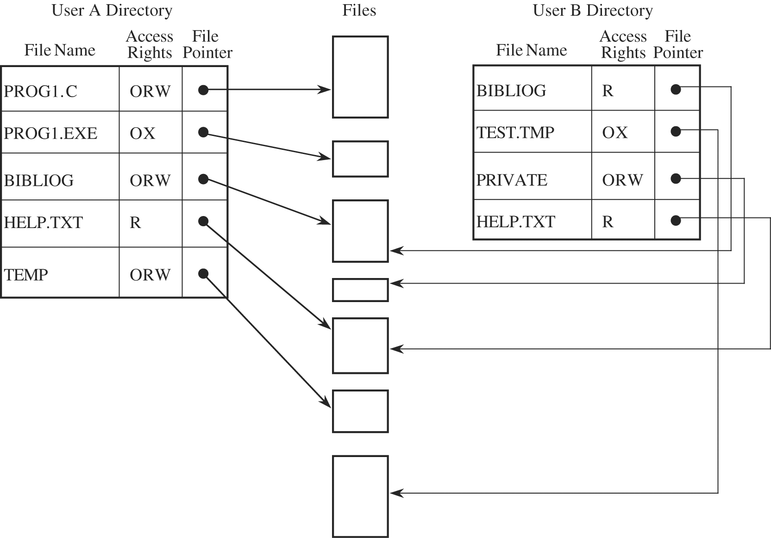
Directory
User wise
Maintained by OS
Rights
  Read
  Write
  Execute
  Owner

Slide 6
Directory
Disadvantages
  Deferent directory for each user
  Large data structures
  Entry for unwanted objects
  Time consuming operations
  Two entries under the same name for different files

Slide 7
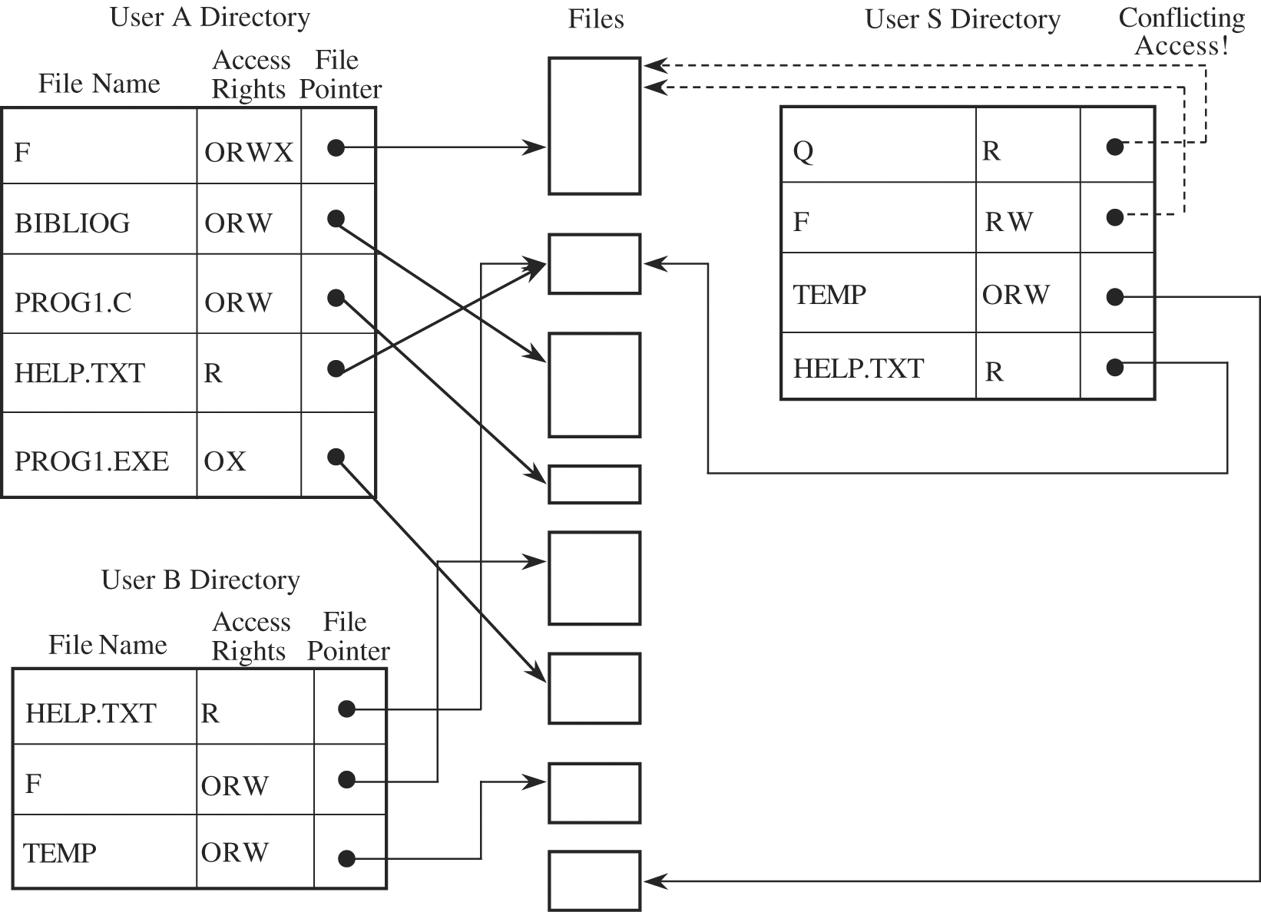
Directory
A:F (or B:F)
Rename by third user

Slide 8
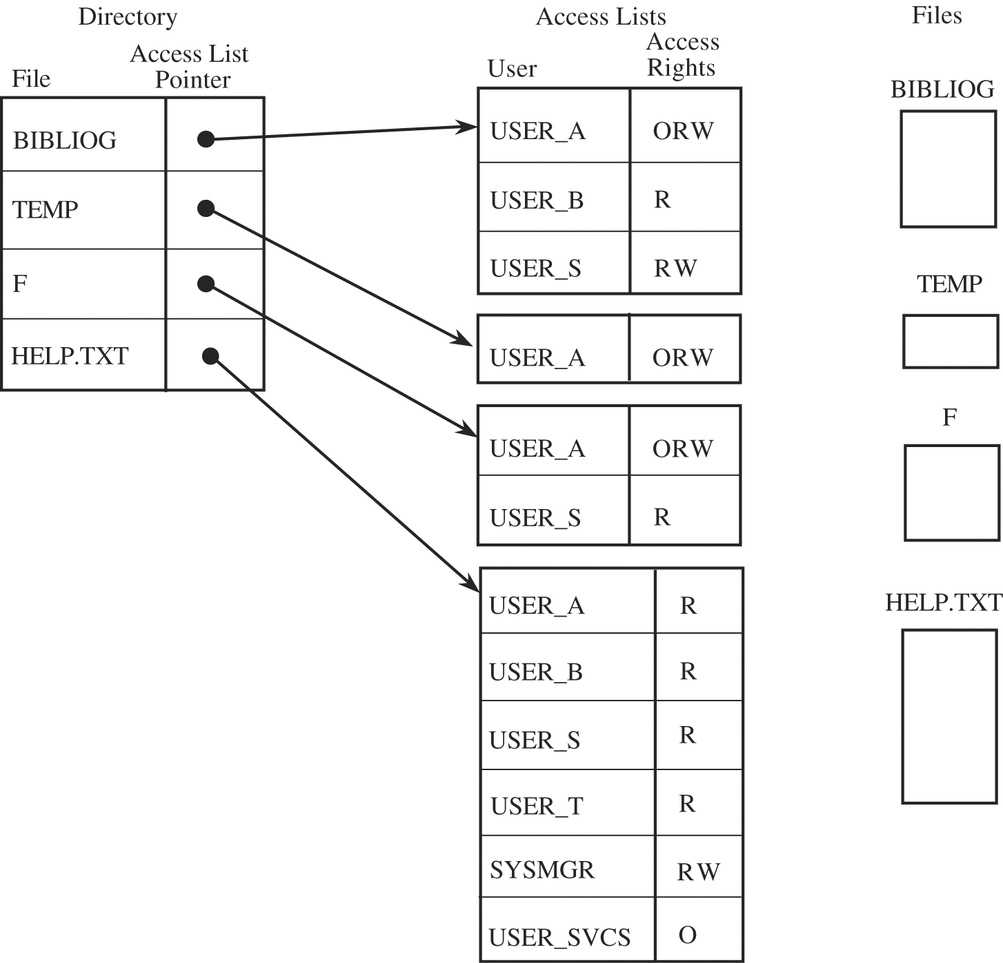
Access Control List
One list for each object
One directory for each subject

Slide 9
Access Control Matrix
<subject, object, rights>
 | BIBLIOG | TEMP | F | HELP.TXT | C_COMP | LINKER | SYS_CLOCK | PRINTER
USER A | ORW | ORW | ORW | R | X | X | R | W
USER B | R | - | - | R | X | X | R | W
USER S | RW | - | R | R | X | X | R | W
USER T | - | - | - | R | X | X | R | W
SYS_MGR | - | - | - | RW | OX | OX | ORW | O
USER_SVCS | - | - | - | O | X | X | R | W

Slide 10
Capability
keep track of the access rights of subjects to objects during execution
Ticket giving permissions
Access to an object
Un-forgeable
  Don’t give the ticket directly to the user
  OS holds
Encrypted
  key available only to the access control mechanism

Slide 11
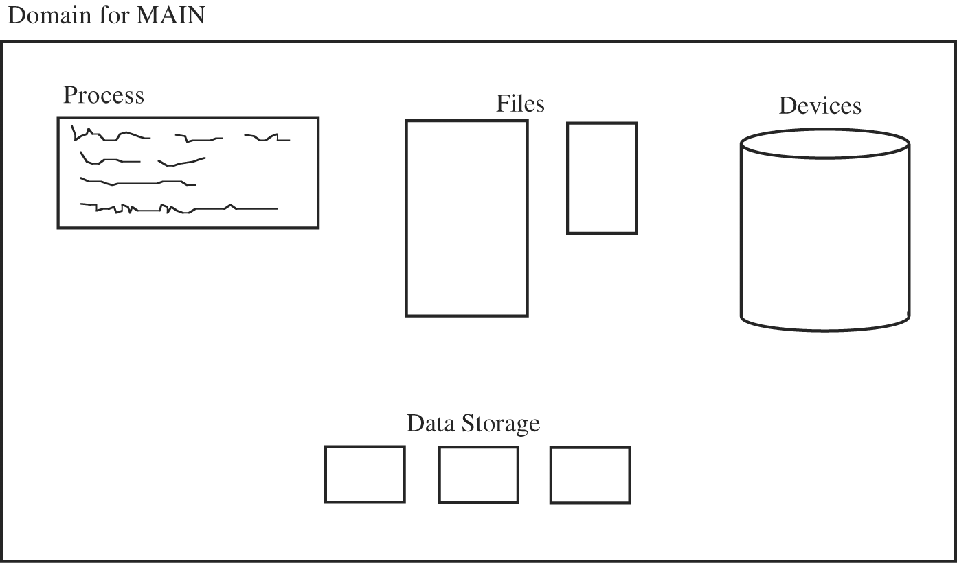
Domain
Local name space
Collection of objects to which process has access
Collection of capabilities

Slide 12
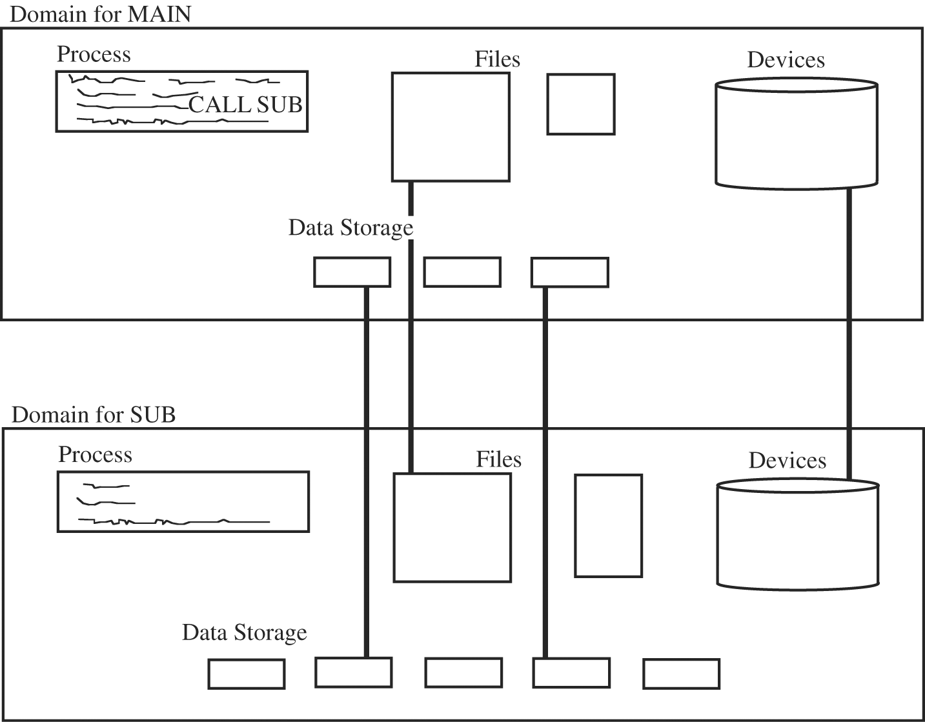
Procedure Calls
Calling sub procedure
Deferent domain
Passing rights
  R,RW
OS create New capabilities

Slide 13
Procedure based Access Control
Procedure that controls access to objects
Trusted interface to accesses object
Users or general operating system routines cant access
No simple, fast access(inefficient)

Slide 14
Role Based Access Control
Deferent users
  Administrators
  Users or guests
Associate privileges
  Users
  Groups
Control access rights by job

Slide 15
File Protection Mechanisms
All-None Protection
  Trust combined with ignorance
  All files are public
  Protected system files by system administrator
  Drawbacks
    Lack of trust
    Not possible to configure selected users
    Rise of sharing
    Complexity
    File listings

Slide 16
File Protection Mechanisms
Group Protection
  User groups
  Common requirements
    Common project
    Department
    class
  Drawbacks
    Group affiliation – other users get permission.
    Limited sharing-only within group

Slide 17
File Protection Mechanisms
Individual Permissions
  Persistent permissions
    Number of access lists
    Revocation is not easy
  Temporary Acquired Permission
    Temporarily acquires access permission
    Only for execution of the program
Problem - meaningful groups of related users

Slide 18
User Authentication
Something the user knows
  Passwords, PIN numbers
Something the user has
  Driver's license
Something the user is –biometrics
  Fingerprint
  Voice pattern
  Retina and iris

Slide 19
Passwords
Problems
  Loss
    Forgotten password
  Use
    Password for each access
    Time consuming
  Disclosure
    Unauthorized individual
  Revocation
    Change password

Slide 20
Additional Authentication
Multifactor authentication
  Department
  Branch
  Workstation
  Time period

Slide 21
Attacks on Passwords
Try all possible passwords
  Exhaustive or brute force attack
Try frequently used passwords
  Qwe, asd,abc,123,abc@123
Try passwords likely for the user
  Meaningful to user
Search for the system list of passwords
Ask the users

Slide 22
Good Practice
Good passwords
Choose long passwords
Avoid meaningful words
Unlikely password
Change the password regularly
Don't write it down
Don't tell anyone else

Slide 23
Loose-Lipped Systems
  UNKNOWN USER ENTER USER NAME:
Adams is not the name

Slide 24
Exhaustive Attack
Brute force attack

Slide 25
Impersonation of Login
User trust the system
Programmer capture the entry parameters
User should interrupt any running process
  Break key
  Ctrl+Alt+Del

Slide 26
Trusted Operating System
Services
  Memory protection
  File protection
  General object access control
  User authentication
    Consistent
    Effective

Slide 27
Trusted Program
Functional correctness
Enforcement of integrity
Limited privilege
Appropriate confidence level

Slide 28
Trusted Operating System Design
Good design principles
  Least privilege
    User , Program
  Economy of mechanism
    Design of the protection should be small, simple
  Open design
    Potential attackers
  Complete mediation
    Permission based. (default condition for denial of access)
  Separation of privilege
    More than one condition
    Authentication plus a cryptographic key

Slide 29
Trusted Operating System Design
Good design principles
  Least common mechanism
    physical or logical separation reduce the risk from sharing
  Ease of use

Slide 30
Features of Protected OS
Identification and Authentication
Mandatory and Discretionary Access Control
  Policy decisions are made beyond the control
  Central authority determines
  User cannot change access rights
Discretionary access control (DAC)
  Objects owner or any authorized user control the access to object

Slide 31
Features of Protected OS
Object Reuse Protection
  Reusing objects is efficient
  Control object reuse by another user
  OS clear or overwrite objects reassigned space before second user

Slide 32
Features of Protected OS
Accountability and Audit
  Maintaining a log of security-relevant events
Audit Log Reduction
Intrusion Detection
  Analyze audit log
  Identify patterns
  Warning

Slide 33
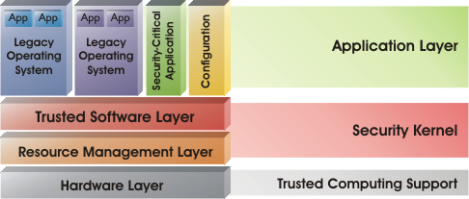
Kernelized Design
Adds yet another layer of interface
Degrade system performance

Slide 34
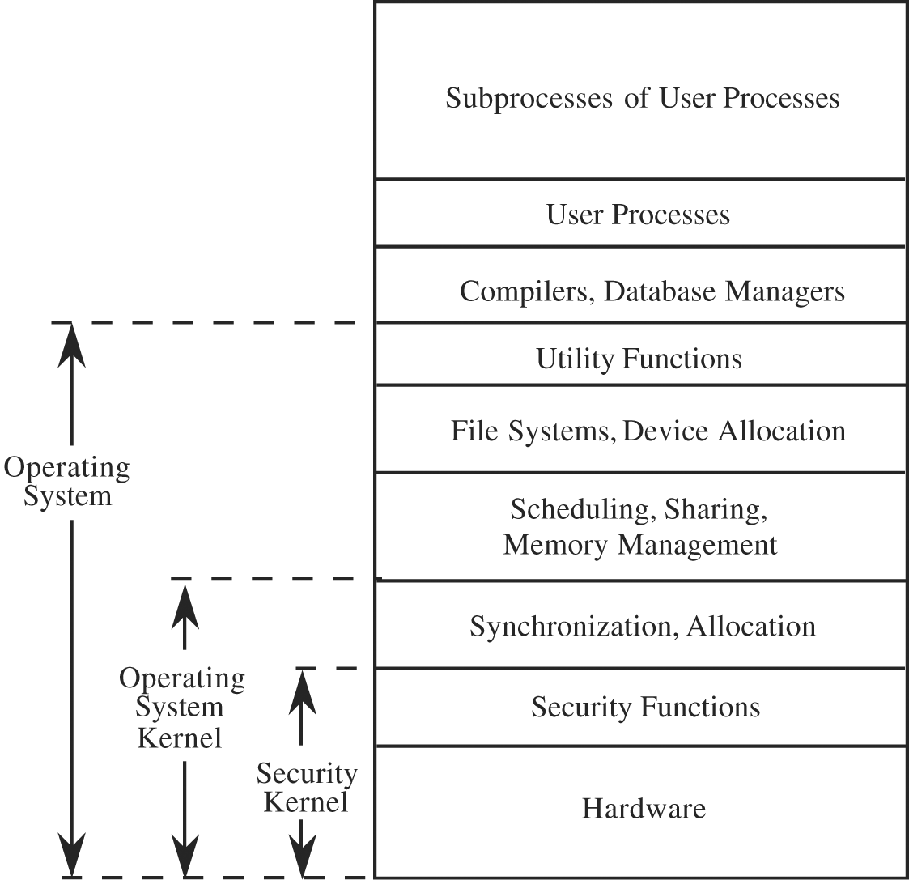
Layered Design
  Hardware
  Kernel
  Operating system
  User

